Slide 2
Most common plant diseases
The first point of contact of these diseases is mainly the leaves. Others may occur in different parts of a pant-like the fruits or stems. However, the most prevailing are leaf diseases.
Types of Leaf Diseases
1. Leaf Spots
2. Early Blight
3. Fusarium wilt
4. Rusts
5. Powdery Mildew
6. Downy Mildew

Slide 3
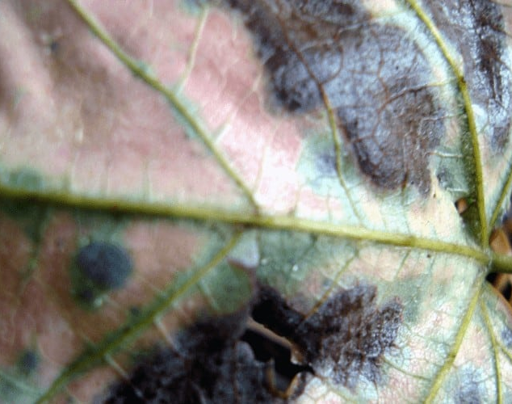
Leaf Spots
Leaf spots, also known as leaf blotch, anthracnose, shot hole, and scab, are typically obvious spots, characterized by alternating shapes, sizes, and shadings.
This spot whose causative agents are fungi or bacteria is mostly encircled consistently by a yellow halo - an unmistakable edge, that’s effortlessly noticeable.
Supposing a fungus brought this spot about, there is almost consistently fungus development of some sort in the spot, especially in a humid climate.
The most common symptoms of leaf spots and potato virus include and rumpling of leaves, more or less noticeable leaf spots

Slide 4
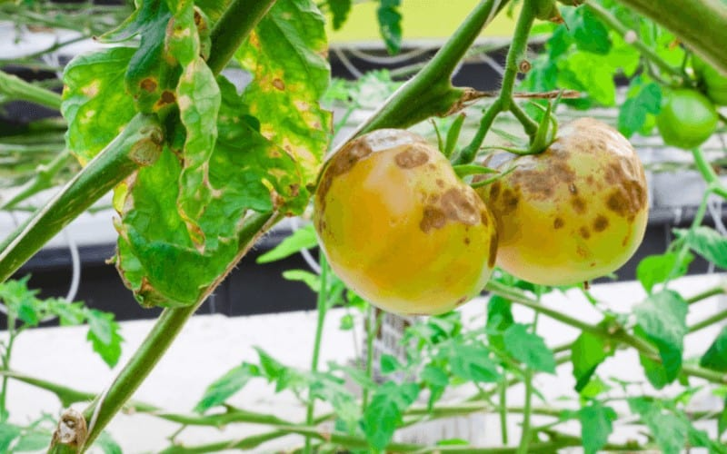
Early Blight
Often seen on potato and tomato plants throughout the United States, early blight is brought about by the “Fungus Alternaria Solani.”
Initially, symptoms show up on the under, older leaves as little earthy colored spots with centered rings that shape into a “bull’s eye” design.
As fungus develops, it expands outward on the leaf exterior, making it shrink, become yellow, until it dies. In the end, the fruits, stem, and plant will get contaminated.
Most common symptoms of early blight and potato virus are lesions

Slide 5
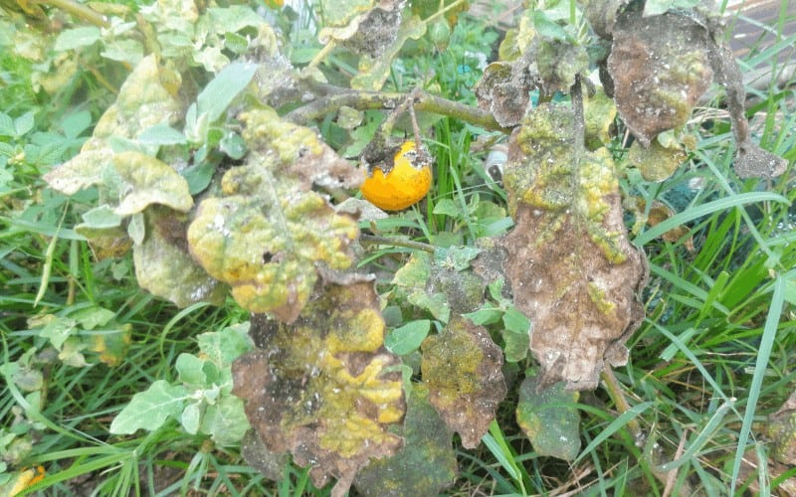
Fusarium Wilt
Fusarium wilt is a ground-borne pathogen commonly found all through the United States. It invades tomato, potato, pepper plants and, eggplant.
The disease symptoms frequently show up later in the developing season and are first seen on the lower (more established) leaves.
As the infection advances, the more youthful leaves will likewise be infected and the plant dies. A rule of thumb says, just one branch or side of the plant show indications.
Most common symptoms of fusarium wilt and potato virus are wilts

Slide 6
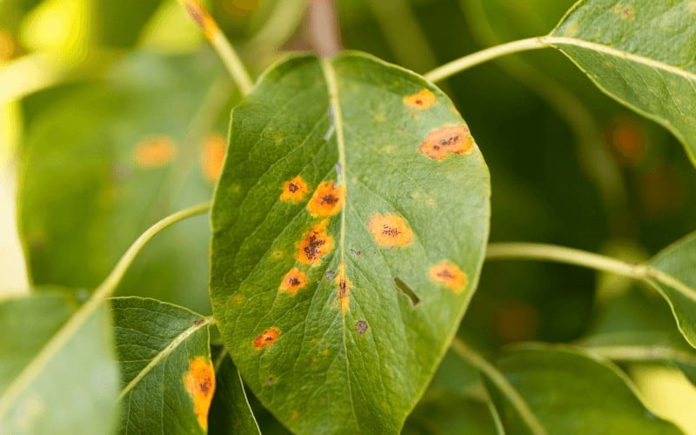
Rusts
Rusts regularly produce spots like leaf spots, however, the spots are classified as “pustules." Rust pustules are radiant yellow, reddish-brown, orange-red, colored, or dark in shading.
Generally, the pustules are seen over the surface of the leaf and, when scoured with a piece of white fabric, a colored spot with similar color as the pustule can ordinarily be seen in the material.
In serious cases, the leaf wilts and dies quickly. A few kinds of rust likewise happen on stems. Rusts are normal on grains and grasses.
Most common symptoms of early blight and potato virus are yellow spots

Slide 7
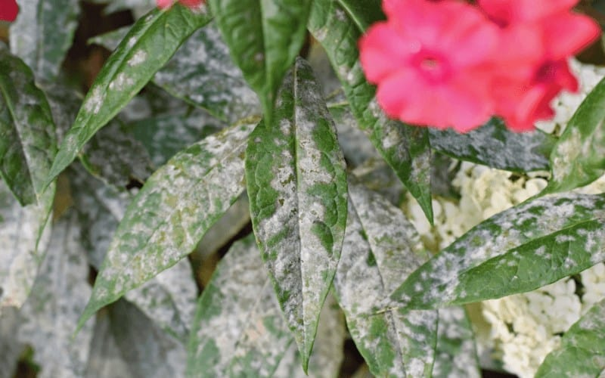
Powdery Mildew
It is a shallow white to light grayish, powdery to coarse growth on leaves, but May also occur on stems and blossoms.
Infected leaves eventually become yellow, wither, and die quickly. The disease is common in cucurbit-type vegetables and grains.
Most common symptoms of early blight and potato virus are lesions

Slide 8
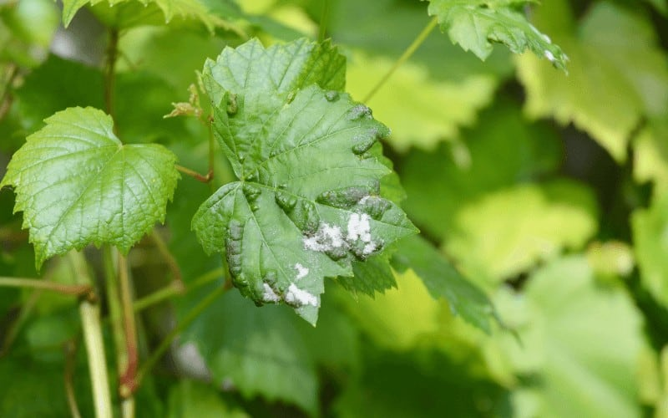
Downy Mildew
Downy mildew symptoms are light yellow-green to yellow zones on the leaf exterior; light dim to purplish mildew growth on the under of the leaf.
The blue form of tobacco is a downy mildew disease. Distorted plant growth may result from downy mildew as seen in grain sorghum.
Most common symptoms of early blight and potato virus are lesions

Slide 9
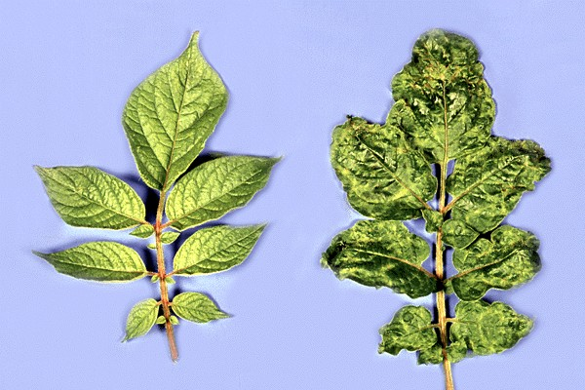
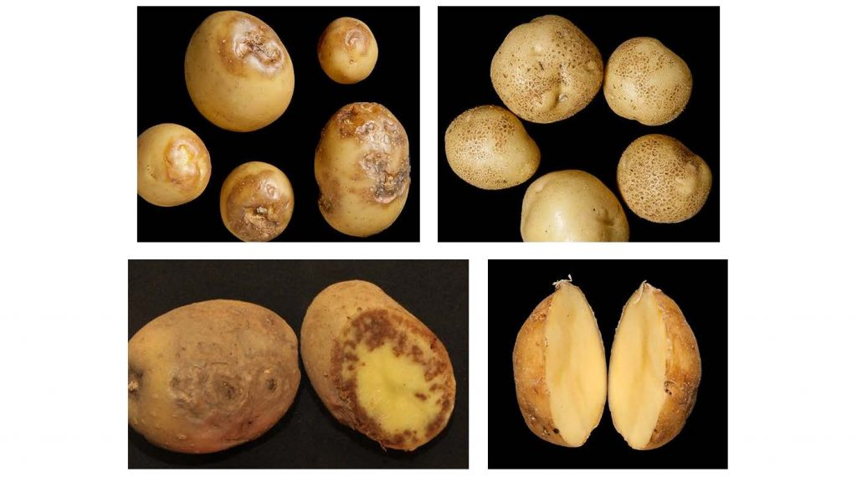
Potato Virus Y
Potato virus Y (PVY) is a plant pathogenic virus of the family Potyviridae, and one of the most important plant viruses affecting potato production.
PVY is an important group of virus that causes “mosaic” symptoms in potato.
Although it mainly affects potatoes it also affects many other food crops.
It is a necrosis kind of virus which leads to destruction of cells, so there is no treatment other than completely removing the plant.
It is mostly rampant in India.

Slide 10
Losses due to PVY
PVY causes huge economic yield losses up to 80% under severe conditions.
In India, the PVY has been also a threat to the cultivation of potato, according to the cultivar, virus strain and environment and causes noteworthy yield losses, up to the extent of 96%.
The plants that were infected with PVY had leaf rolling, stuntedness, leaf distortion, reduction in leaf size and light yellow mosaics, and in some cases, purple or red margins were observed,.
The high disease severity culminated in a significant effect on yield, plant growth height and plant vigor, which were different across the varieties.

Slide 11
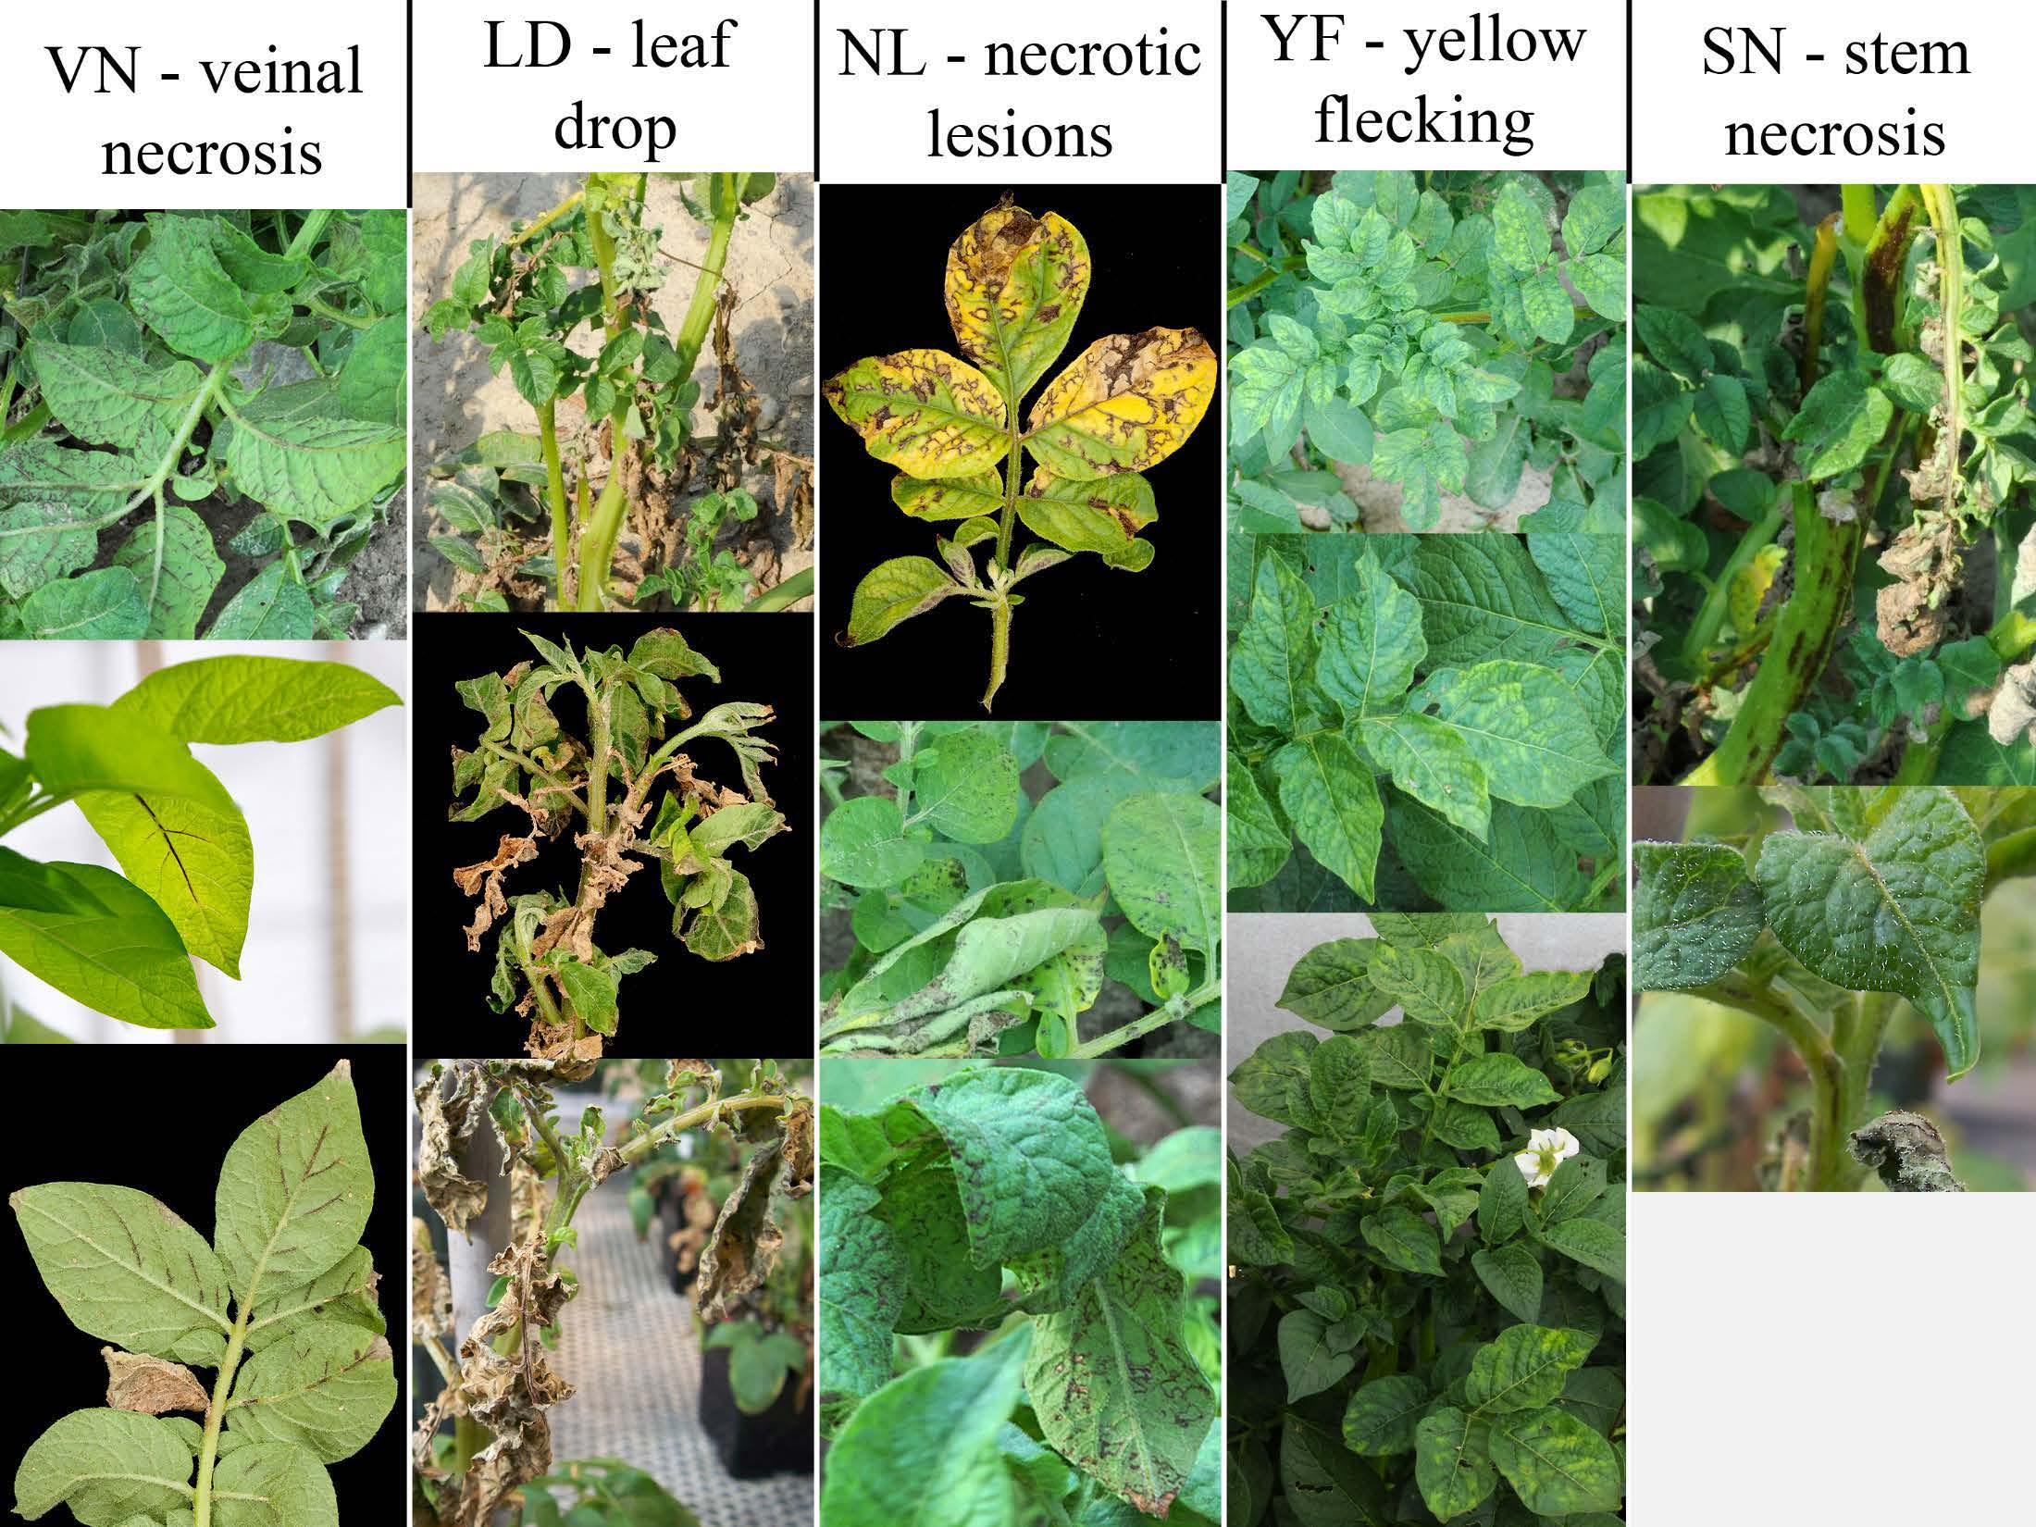
Misidentification
It is very important to identify the potato virus correctly.
We need to identify PVY as quickly as possible so that we can prevent the spreading by removing the section on which it has occurred since it has no cure.
If we are late in identifying the virus it may spead to the whole plant and It may even spread to the whole farm.
If we misidentify PVY for any other plant disease and misdiagnose the plant then the virus may spead and kill the plant.
The image shows symptoms of PVY that are common to the above infections talked about.

Slide 12
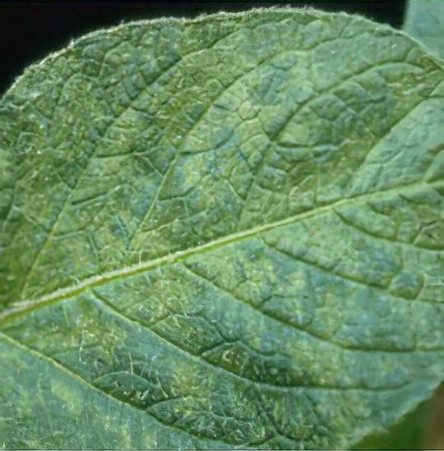
Characteristic features of Viral diseases and identification using AI
Viral diseases are very hard to identify at first glance. They are often neglected and not noticed until very late.
The most important characteristic of a viral infection is the appearance of a mosaic patters. They are hard to identify with the naked eye.
Hench AI can help by looking at the overall pattern, not requiring any closer observation in a lab.
The image shows very late stage potato virus but the leaf looks indistinguishable from a regular one.

Slide 13
What we are trying to do
Mobile application for farmers to get quick and accurate diagnosis with the help of AI reducing chances of misdiagnosis
Blog page for researchers with recent data from farmers obtained with graphs showing any advents or breakouts of diseases
Web page publicly accessible to everyone to see the common diseases and it’s prevention
Web page also displays the recent activity on their mobile phone application, suggesting recommended actions
Distinguish different variants of Potato virus by the overall pattern of mosaics

